Slide 1

WFIRST CGI
OS9 Time Series Simulations
(Shaped Pupil Coronagraph, Band 3, with MUFs)
John Krist
(Jet Propulsion Laboratory, California Inst. of Technology)
14 May 2020
© 2020, California Institute of Technology. All rights reserved. Government sponsorship acknowledged.

Slide 2
Results include contributions from:
JPL WFIRST CGI Integrated Modeling Team (John Steeves, Charley Noecker,
Navtej Saini, Erkin Sidick): STOP modeling & LOWFS modeling
JPL CGI MTS Team: CGI Finite Element Model
JPL CGI SE Team: Brian Kern (OS definition)
JPL CGI PACE Team (Milan Mandic, Nanaz Fathpour): Jitter
GSFC WFIRST Integrated Modeling Team: STOP model integration, reaction wheel speeds
Bijan Nemati & Sam Miller (U. Alabama): EMCCD model

Slide 3
Some definitions
primary-normalized flux: image is normalized to the flux incident on the illuminated area of the primary mirror. There are no losses from reflections, filters, QE, etc, but there are losses from mask. In the absence of masks, the total image intensity would be 1.0.
normalized intensity: the per-pixel brightness of the dark hole divided by the peak pixel of the unocculted star. This is sort of a poor man’s contrast (because it does not account for field variations in the PSF, especially near the IWA).
Array dimension ordering is specified here in IDL ordering (fastest-varying index 1st),
the opposite of Python & Matlab

Slide 4
OS9
  Begin with slew from a WFI High Latitude Survey target to the bright reference star (ζ Pup, V=2.25, O4I), then spend 30 hours to settle
  Assume dark hole was previously dug at some earlier time and just needs some tweaking
  Observation cycle:
    4 h of maintenance EFC on ζ Pup; assume 1 iteration every 2 hours
    1 h of imaging on ζ Pup (1st observation begins at hour 34 in timeline)
    slew to the target star (47 UMa, V=5.04, G1V)
    2 h each on 47 UMa at rolls of -11°, +11°, -11°, +11° from solar-normal roll
    slew to ζ Pup
    1 h of imaging on ζ Pup
  Repeat observation cycle 3 times (HLC) or 14 times (SPC spectrum)

Slide 5
Modeling Timesteps
The STOP model was run with 20 min timesteps to produce aberration & pupil drifts
Results interpolated to 5 min timesteps
  STOP model assumed instantaneous slews, but jitter model included slew/roll times, both covering the same total amount of time
  slew times were taken out of STOP on-target times, resulting in irregular number of timesteps on each star/roll
  these issues will be fixed in OS10
LOWFS model run to produce DM correction patterns and focus correction residuals, which were fed into the PROPER Phase B diffraction model
Jitter model, using wheel speeds tailored for OS9, produced LOS RMS jitter at 0.25 sec timesteps, then converted to RMS jitter over 100 sec span
For each timestep, PROPER produced complex-valued speckle electric fields with 0.1 λ_{c}/D sampling for 9 wavelengths at each of 4 polarization states (±45° in, 0° & 90° out); these data are included in the distribution
Gaussian jitter & stellar size applied as weights in linear optical model to E-fields, added in intensity, then summed in polarization to produce monochromatic images vs wavelength at each timestep

Slide 6
Modeling Flow
Thermal &
Structural FEMs
Observing scenario
times & angles,
CGI power profile
Dynamic
structural
model
Reaction
wheel speeds
LOS jitter PSDs
Telescope,
TCA
Integrated FEM
RMS LOS,
Z4-Z11 jitter
Observatory,
WFI,
spacecraft
JPL IM Pipeline
Thermal Desktop,
NASTRAN
Thermal Desktop,
NASTRAN
Diffraction
model
CGI
Linear optical model
Sigfit,
Code V
CGI speckle
time series
Legend
Harris
GSFC
OS WFE
Zernikes,
pre-CGI beam shears
OS WFE
Zernikes, beam shears, DM temps
Detector
model
JPL

Slide 7
Errors Included in OS9
Wavefront error changes from thermal drift
  Z4 – Z45 (Noll ordering)
  Z4 – Z11 LOWFS sensed & corrected with measurement & DM errors
LOWFS/C
  Star brightness-dependent measurement errors (but no color terms)
  15 bit DM DAC with gain errors
Beam shears
  Instrument carrier (IC) to CGI shear (displacement directly from structural model)
  Shears at all optics will be computed in full model for OS10
DM thermal drift (from mini-STOP CGI-only model)
  Will be computed in full model for OS10
Pointing (LOWFS-corrected) jitter
All optical aberrations, including polarization

Slide 8
Modeling Uncertainty Factors (MUFs)
No thermal MUF
2x structural deformation MUF
  increases beam shear, wavefront error drift by 2x
Frequency-dependent jitter MUFs
  3x (<20 Hz), 4.27x (40-100 Hz), 8x (>100 Hz)
    In Phase A, OS6: 2.07x (<20 Hz), 4.27x (>40 Hz)
CGI sensitivity MUFs
  2x contrast sensitivity to low-order errors (jitter, polarization)
  1.5x polarization aberrations
  2x starting contrast
Always
included
Included
only when
specified
Only simulations with the sensitivity MUFs are included in this distribution.

Slide 9
Zernike changes from STOP modeling (pre-LOWFS/C)
OS9 Zernikes Z4-Z8
Grey regions are time
on reference star
Focus
0° Astig
X Coma
45° Astig
Y Coma

Slide 10
Zernikes changes from STOP modeling (pre-LOWFS/C)
Grey regions are time
on reference star
5th Spherical
Y Trefoil
X Trefoil
7th Spherical
3rd Spherical

Slide 11
Instrument Carrier/CGI interface pupil shear from STOP modeling
(MUF applied)
Grey regions are time
on reference star
X
Pupil diameter
at interface = 40 mm
Y

Slide 12
DM temperature change from STOP modeling
Grey regions are time
on reference star
Temperature changes
dominated by heating
due to mechanism motion;
lags due to thermal control
DM_{new}[x,y] = DM_{old}[x,y](1 + 0.026 Δ_{tempK})

Slide 13
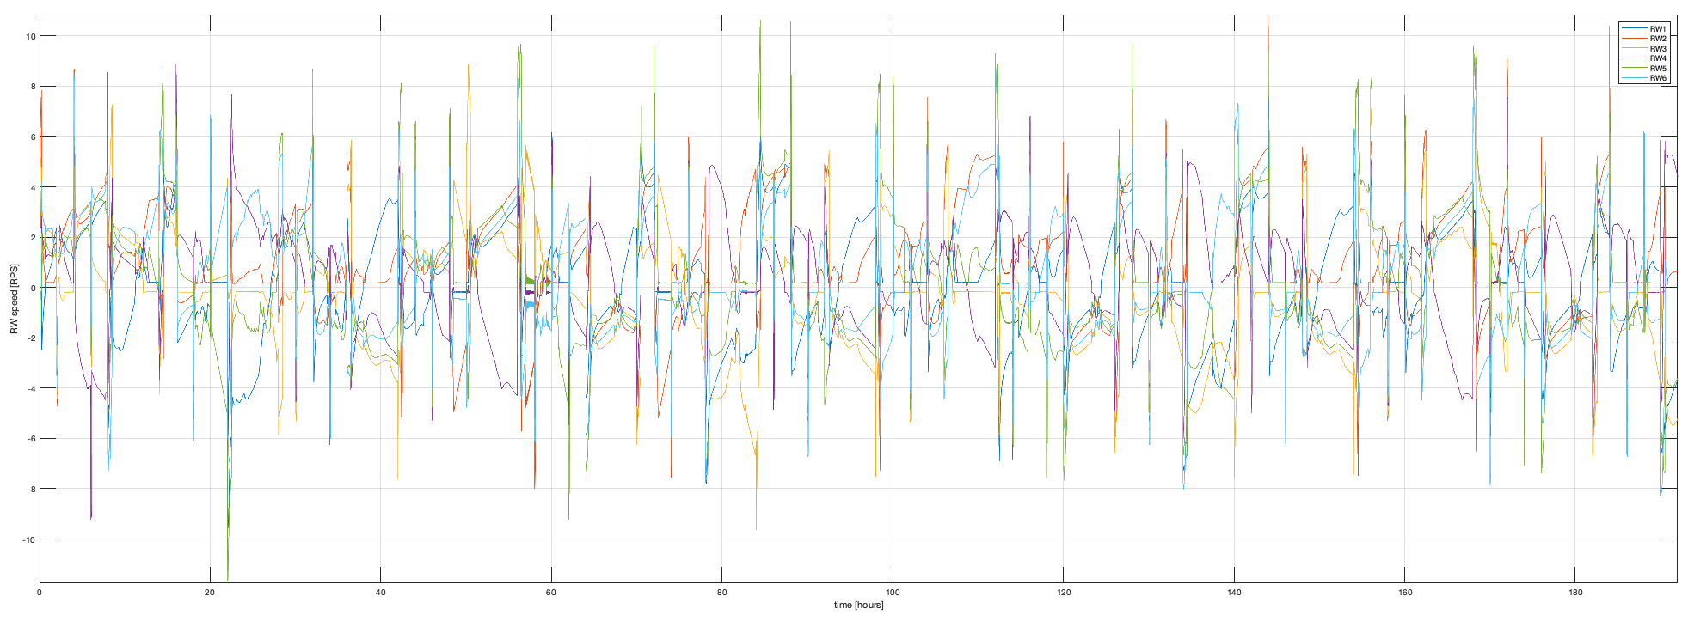
OS9 Wheel Speeds
Reaction wheel speed (RPS)
35
55
75
95
115
135
155
175
195
215
Time (hours)

Slide 14
OS9 Line-of-sight Jitter (Post-FSM)
Cycle 1
Cycle 2
Cycle 14
Grey regions are time
on reference star

Slide 15



SPC-Spectrum Band 3 Simulations
SPC-20190130 (Phase B flight design)
  Bowtie FPM
  r = 3 – 9 λ_{c}/D dark hole
Band 3: 15%, 675 – 785 nm, λ_{c}=730 nm
Simulations run for with-sensitivity-MUFs case only
Pupil Mask
Focal Plane Mask
Lyot Stop

Slide 16
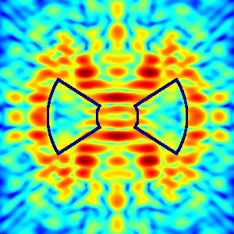

SPC-Spectrum Band 3 Simulations
1st Timestep, no jitter, sum of wavelengths
10⁻⁷
10⁻⁸
Normalized Intensity
10⁻⁹
10⁻¹⁰
SPC FPM pattern superposed

Slide 17
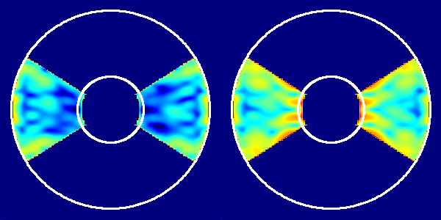
SPC-Spectrum Band 3 Simulations
Polarization
Coherent + Incoherent
Components
Coherent Component
Wavefront control senses and corrects the coherent component of the dark hole field, which is essentially the mean of the X and Y polarizations. The X-Y residual, plus the cross-terms, form the incoherent component. The simulations here show that the SPC in Band 3 is significantly impacted in terms of static dark hole contrast by the incoherent component. In WFIRST the polarization aberrations are at their minimum at ~575 nm and increase away from there. The longer Band 3 wavelengths, plus the 1.5x polarization aberration and 2x low order aberration sensitivity MUFs, result in significant incoherent light in the dark hole.
10⁻⁷
10⁻⁸
Normalized Intensity
10⁻⁹
10⁻¹⁰
Circles are
r = 3 & 9 λ/D
No jitter included
Bowtie mask applied to images

Slide 18
SPC-Spectrum Band 3 Simulations
Mean Norm Intensity vs Time (3-5 λ_{c}/D)
RMS ΔNorm Intensity vs Time=34h (3-5 λ_{c}/D)
Mean Norm Intensity
RMS ΔNorm Intensity
Hour
Hour
Grey regions are time
on reference star

Slide 19
SPC OS9 Distribution
The OS9 SPC simulations are distributed as images vs wavelength vs timestep
  Timesteps are 5 minutes with longer gaps between for slews/rolls
The timeline is split into cycles 1 – 14
  each cycle starts with reference star images, followed by multi-roll target star images, and then ends with more reference star images
  see annotation on plot on page 14
The image files are os9_images_cycle1.fits, etc.
  Each monochromatic image is primary normalized flux (no spectrum or reflection/filter losses included)
There is an info file (e.g., os9_info_cycle1.fits) for each cycle that lists information for each corresponding timestep in the images file
  time in hours (start = 34 h)
  star (0=reference, 1=target),
  cycle
  roll orientation (-11, 0, or +11 degrees)
  Set ID = identifier for a particular group of observations (first batch of reference star images in a cycle have one ID, then the 1st set of target star images at one roll have another, etc.)
Note that the dark-hole-update timespans (~4 hours/cycles) are not included

Slide 20
Files in OS9 Distribution
os9_inputs.txt : Text table of the timestep (hours, beginning at 34) and the STOP-model-derived wavefront (Z4-Z45 in meters RMS, unobscured) and pupil shear (microns) changes relative to the 1st timestep (hour 34) in 5 min intervals (2127 total). Timesteps during slews, rolls, or EFC wavefront maintenance are omitted. The Z4 value is the value after compensation by the focus correction mirror (including measurement error). The Z5-Z45 values are the raw, uncorrected Zernike aberrations.
os9_jitter.txt : Text table giving the post-FSM X and Y jitter (mas RMS per axis) versus time.
os9_images_cycle*.fits : array [nx=300,ny=300,nlam=29,ntimes] of monochromatic speckle field images, each timestep corresponding to an entry in os9_info_cycle*.txt. Each monochromatic image is the sum of the 4 polarization components and is primary-normalized flux. Sampling is 0.1 λ_{c}/D. Time-dependent jitter is included.
os9_psfs.fits : array [nx=300,ny=300,nr=18,nangle=10] of images at 0.1 λ_{c}/D sampling with the source offset by various amounts in radius (irregular offsets spanning the field) and angle (-11, 0, +11 degrees). Jitter not included. See “Offset Source Images” in a following slide for more info.
os9_psfs_r_offset.fits,
os9_psfs_angle_offset.fits : the corresponding offsets in radius (λ_{c}/D) from the center and angle (degrees) for os9_psfs.fits.
spc_fpm.fits: The SPC bow-tie focal plane mask pattern at 0.1 λ_{c}/D sampling, for identifying which portions of the images were unocculted at the FPM.

Slide 21
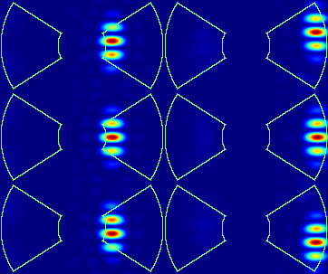
Offset Source Images
r = 3.0 λ/D
r = 8.0 λ/D
os9_psfs.fits contains images of the source offset by
various amounts in radius and angle from the center
of the FPM over one quadrant of the dark hole.
It is a [nx,ny,nlam,r,θ ] = [300,300,18,3] array. The images
are primary-flux-normalized.
These 300 x 300 pixel images are sampled by 0.1 λ_{c}/D.
They are provided at 29 wavelengths evenly sampling the
Band 3 passband.
The corresponding offsets in radius (λ_{c}/D) and angle
(degrees) are provided in the files os9_psfs_r_offset.fits
and os9_psfs_angle_offset.fits. Each is a [18,3] array.
The offsets are:
r = 2.0, 2.2, 2.4, 2.6, 2.8, 3.0, 3.2, 3.4, 3.6, 3.8, 4.0, 5.0, 6.0, 7.0, 8.0, 8.3, 8.6, 8.9 λ_{c}/D
θ = -11, 0, +11 degrees
θ = +11°
θ = 0°
θ = -11°
SPC FPM pattern superposed

Slide 22
Common File Header Keywords
MINLAM, MAXLAM = min, max bandpass wavelength in microns
LAMBDA = bandpass central wavelength in microns
PIXSCALE = Spatial sampling in LAMBDA/D
PIX_AS = Spatial sampling in arcseconds
XCENTER, YCENTER = image coordinate of FPM center (0.0,0.0 is lower left edge of 1st pixel; center of any pixel is (*.5,*.5)
UNITS = data value units; for images, flux units

