Slide 1

WFIRST CGI
OS9 Time Series Simulations
(Hybrid Lyot Coronagraph, Band 1)
John Krist
(Jet Propulsion Laboratory, California Inst. of Technology)
1 May 2020
Revised 19 May 2020
© 2020, California Institute of Technology. All rights reserved. Government sponsorship acknowledged.

Slide 2
Results include contributions from:
JPL WFIRST CGI Integrated Modeling Team (John Steeves, Charley Noecker,
Navtej Saini, Erkin Sidick): STOP modeling & LOWFS modeling
JPL CGI MTS Team: CGI Finite Element Model
JPL CGI SE Team: Brian Kern (OS definition)
JPL CGI PACE Team (Milan Mandic, Nanaz Fathpour): Jitter
GSFC WFIRST Integrated Modeling Team: STOP model integration, reaction wheel speeds
Bijan Nemati & Sam Miller (U. Alabama): EMCCD model

Slide 3
Some definitions
primary-normalized flux: image is normalized to the flux incident on the illuminated area of the primary mirror. There are no losses from reflections, filters, QE, etc, but there are losses from mask. In the absence of masks, the total image intensity would be 1.0.
normalized intensity: the per-pixel brightness of the dark hole divided by the peak pixel of the unocculted star. This is sort of a poor man’s contrast (because it does not account for field variations in the PSF, especially near the IWA).
Array dimension ordering is specified here in IDL ordering (fastest-varying index 1st),
the opposite of Python & Matlab

Slide 4
OS9
  Begin with slew from a WFI High Latitude Survey target to the bright reference star (ζ Pup, V=2.25, O4I), then spend 30 hours to settle
  Assume dark hole was previously dug at some earlier time and just needs some tweaking
  Observation cycle:
    4 h of maintenance EFC on ζ Pup; assume 1 iteration every 2 hours
    1 h of imaging on ζ Pup (1st observation begins at hour 34 in timeline)
    slew to the target star (47 UMa, V=5.04, G1V)
    2 h each on 47 UMa at rolls of -11°, +11°, -11°, +11° from solar-normal roll
    slew to ζ Pup
    1 h of imaging on ζ Pup
  Repeat observation cycle 3 times (HLC) or 14 times (SPC spectrum)

Slide 5
Modeling Timesteps
The STOP model was run with 20 min timesteps to produce aberration & pupil drifts
Results interpolated to 5 min timesteps
  STOP model assumed instantaneous slews, but jitter model included slew/roll times, both covering the same total amount of time
  slew times were taken out of STOP on-target times, resulting in irregular number of timesteps on each star/roll
  these issues will be fixed in OS10
LOWFS model run to produce DM correction patterns and focus correction residuals, which were fed into the PROPER Phase B diffraction model
Jitter model, using wheel speeds tailored for OS9, produced LOS RMS jitter at 0.25 sec timesteps, then converted to RMS jitter over 100 sec span
For each timestep, PROPER produced complex-valued speckle electric fields with 0.1 λ_{c}/D sampling for 9 wavelengths at each of 4 polarization states (±45° in, 0° & 90° out); these data are included in the distribution
Gaussian jitter & stellar size applied as weights in linear optical model to E-fields, added in intensity, then summed in polarization to produce monochromatic images vs wavelength at each timestep
Appropriate stellar spectra were multiplied by the system throughput curve to weight the monochromatic images, which were then summed to produce a broadband images with appropriate flux rates; these are included in the distribution
Speckle images were interpolated in time to produce images at EMCCD framerates (5s for target, 100s for reference), binned to CCD resolution (0.021 arcsec = 0.42 λ_{c}/D), and fed into the EMCCD model; these are included in the distribution
  335 reference images @ 100 s each
  7080 target star images @ 5 s each at roll #1
  7320 target star images @ 5 s each at roll #2

Slide 6
Modeling Flow
Thermal &
Structural FEMs
Observing scenario
times & angles,
CGI power profile
Dynamic
structural
model
Reaction
wheel speeds
LOS jitter PSDs
Telescope,
TCA
Integrated FEM
RMS LOS,
Z4-Z11 jitter
Observatory,
WFI,
spacecraft
JPL IM Pipeline
Thermal Desktop,
NASTRAN
Thermal Desktop,
NASTRAN
Diffraction
model
CGI
Linear optical model
Sigfit,
Code V
CGI speckle
time series
Legend
Harris
GSFC
OS WFE
Zernikes,
pre-CGI beam shears
OS WFE
Zernikes, beam shears, DM temps
Detector
model
JPL

Slide 7
Errors Included in OS9
Wavefront error changes from thermal drift
  Z4 – Z45 (Noll ordering)
  Z4 – Z11 LOWFS sensed & corrected with measurement & DM errors
LOWFS/C
  Star brightness-dependent measurement errors (but no color terms)
  15 bit DM DAC with gain errors
Beam shears
  Instrument carrier (IC) to CGI shear (displacement directly from structural model)
  Shears at all optics will be computed in full model for OS10
DM thermal drift (from mini-STOP CGI-only model)
  Will be computed in full model for OS10
Pointing (LOWFS-corrected) jitter
All optical aberrations, including polarization & FPM fabrication errors
EMCCD noise
  No cosmic rays or traps in this set

Slide 8
Modeling Uncertainty Factors (MUFs)
No thermal MUF
2x structural deformation MUF
  increases beam shear, wavefront error drift by 2x
Frequency-dependent jitter MUFs
  3x (<20 Hz), 4.27x (40-100 Hz), 8x (>100 Hz)
    In Phase A, OS6: 2.07x (<20 Hz), 4.27x (>40 Hz)
CGI sensitivity MUFs
  2x contrast sensitivity to low-order errors (jitter, polarization)
  1.5x polarization aberrations
  2x starting contrast
Always
included
Included
only when
specified

Slide 9
Zernike changes from STOP modeling (pre-LOWFS/C)
OS9 Zernikes Z4-Z8
Grey regions are time
on reference star
0° Astig
X Coma
Focus
45° Astig
Y Coma
Ref #1
Ref #3
Ref #5
Ref #2
Ref #4
Ref #6
EFC #1
EFC #3
EFC #2
EFC #4

Slide 10
Zernikes changes from STOP modeling (pre-LOWFS/C)
Grey regions are time on reference star

Slide 11
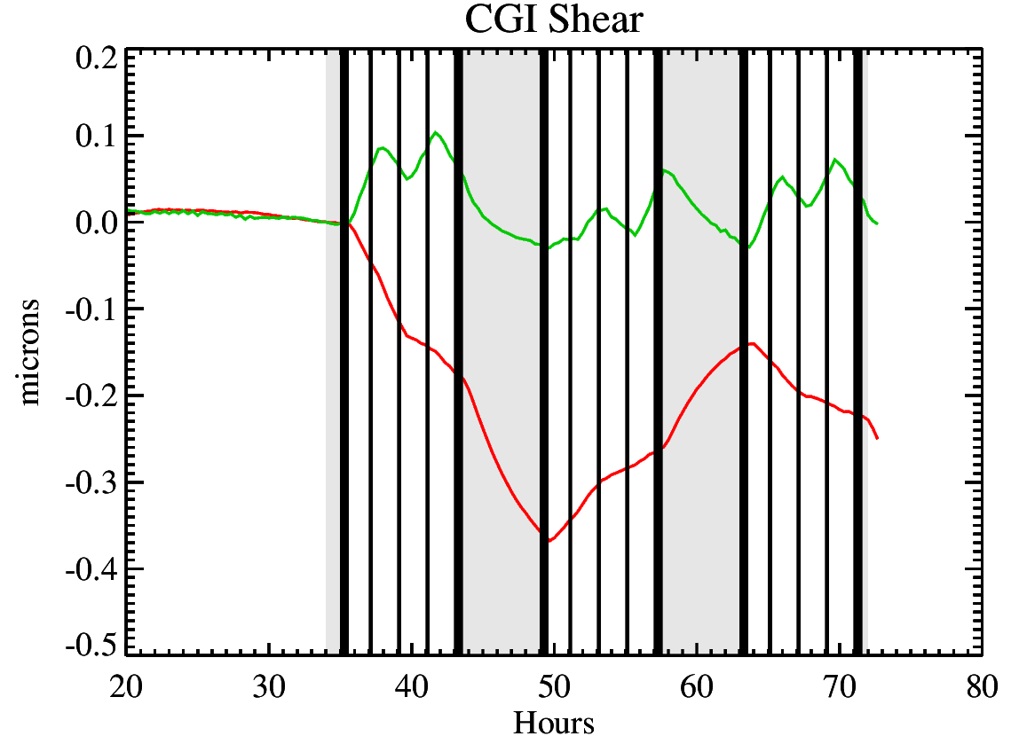
Instrument Carrier/CGI interface pupil shear from STOP modeling
(no MUF applied in plot)

Slide 12
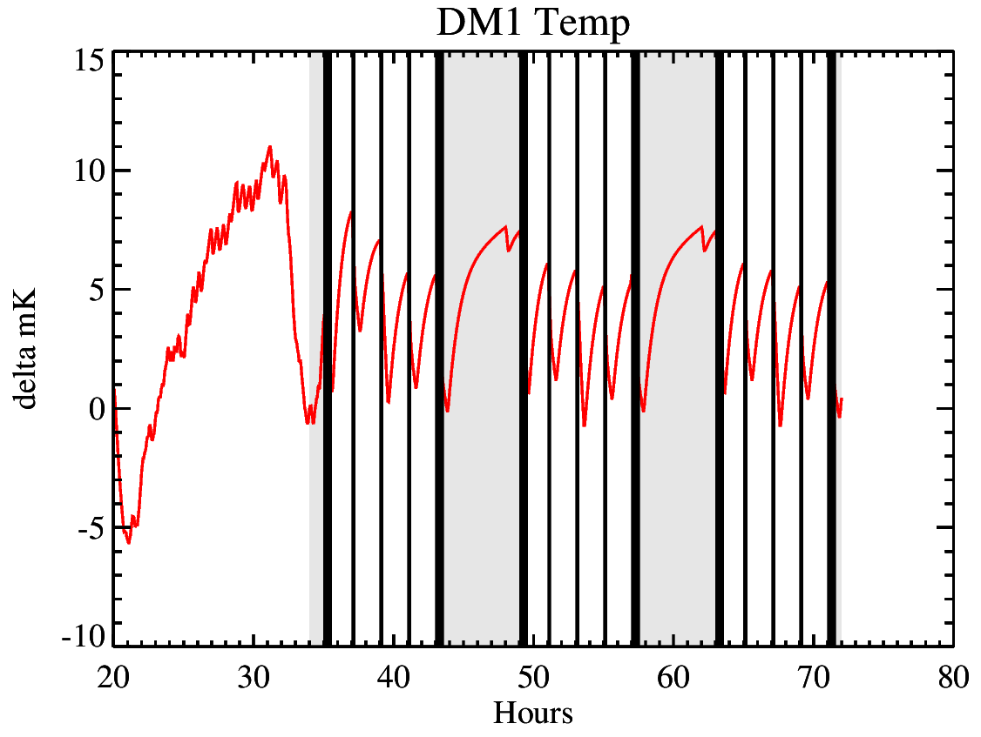
DM temperature change from STOP modeling
Temperature changes
dominated by heating
due to mechanism motion;
lags due to thermal control
DM_{new}[x,y] = DM_{old}[x,y](1 + 0.026 Δ_{tempK})

Slide 13
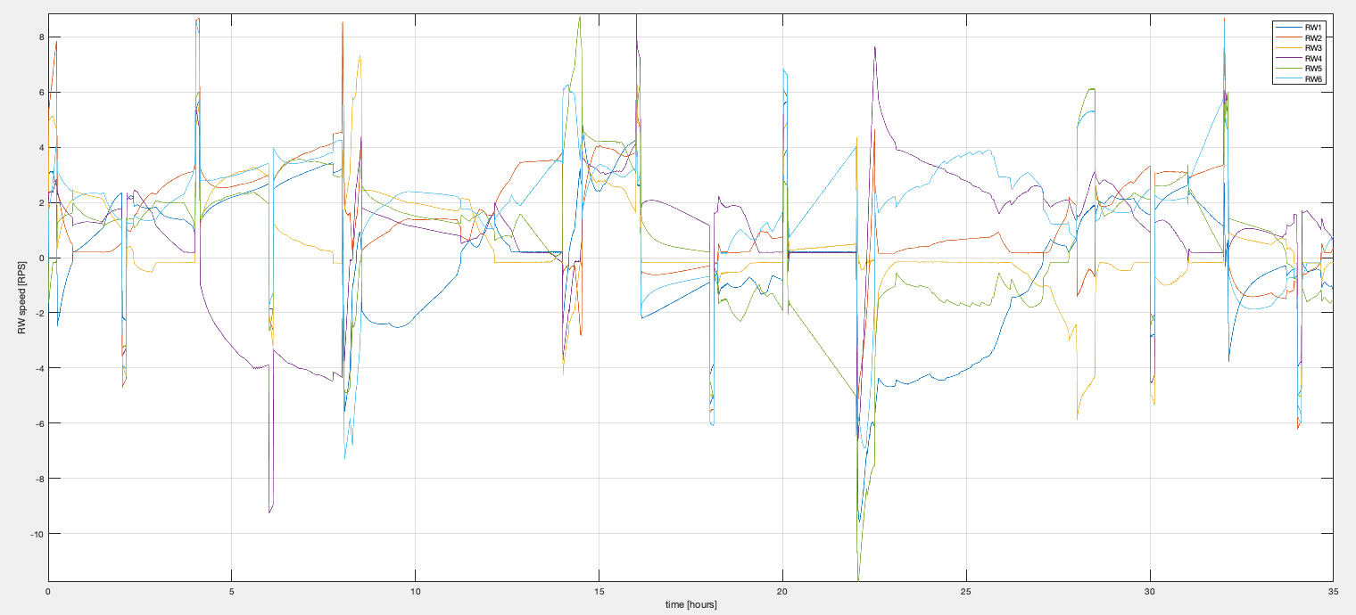
OS9 Wheel Speeds
35
40
45
50
55
60
65
70

Slide 14
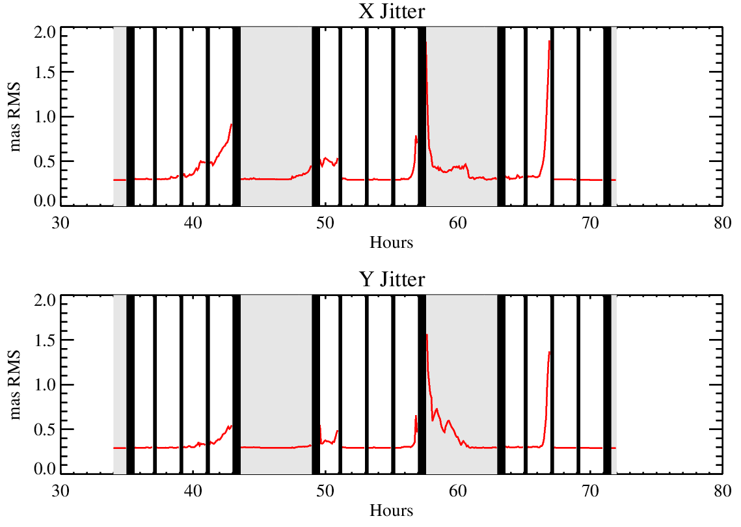
OS9 Line-of-sight Jitter (Post-FSM)

Slide 15
HLC Band 1 Simulations
HLC-20190210 (Phase B flight design)
  FPM has azimuthally-varying dielectric over hard-edged, partially-transmissive nickel spot
  r = 3 – 9 λ_{c}/D dark hole
Band 1: 546 – 603 nm, λ_{c}=575 nm
System model uses a modified FPM with fabrication errors
  5% dielectric pattern thickness error
  100 nm dielectric thickness error
  5% nickel thickness error
Control model used by EFC has as-designed FPM

Slide 16
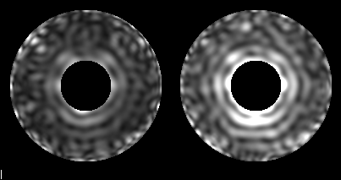
OS9 Time Series (HLC): With, without sensitivity MUFs
(noiseless, infinite signal)
With
Sensitivity
MUFs
Mean Normalized Intensity 3-5 λ/D
No Sensitivity
MUFs
Mean Normalized Intensity
34 h
72 h
MOVIE
(play in presentation mode)

Slide 17
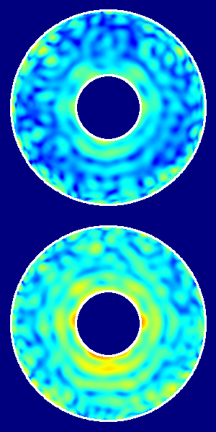

Initial Timestep Normalized Intensity
Without sensitivity MUFs
10⁻⁷
10⁻⁸
Normalized Intensity
With sensitivity MUFs
Mean Normalized Intensity
With sensitivity MUFs
10⁻⁹
10⁻¹⁰
Without sensitivity MUFs
λ / D

Slide 18
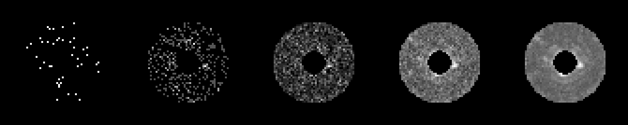
Target Star (47 UMa) Accumulated Exposures
HLC, V = 5.04, Photon-counted frames
5 s
50 s
500 s
5000 s
35000 s

Slide 19
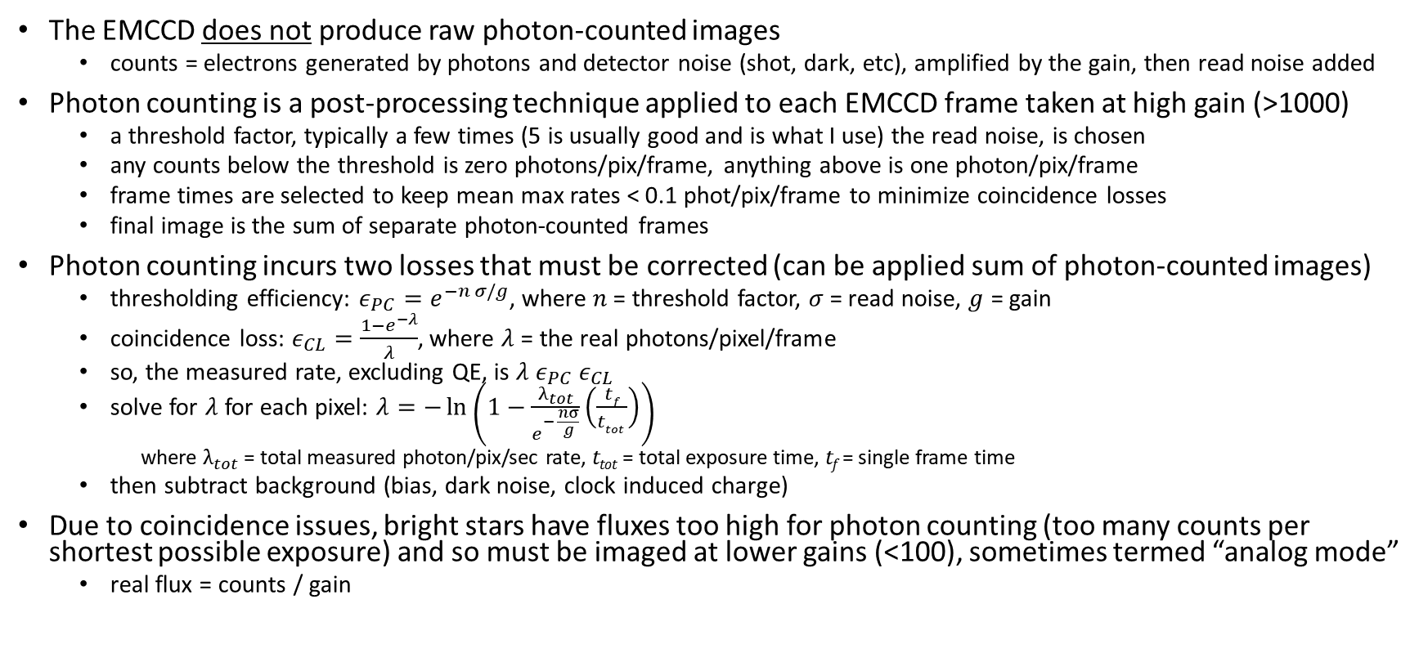
EMCCD Image Processing
The EMCCD does not produce raw photon-counted images
  counts = electrons generated by photons and detector noise (shot, dark, etc), amplified by the gain, then read noise added
Photon counting is a post-processing technique applied to each EMCCD frame taken at high gain (>1000)
  a threshold factor, typically a few times (5 is usually good and is what I use) the read noise, is chosen
  any counts below the threshold is zero photons/pix/frame, anything above is one photon/pix/frame
  frame times are selected to keep mean max rates < 0.1 phot/pix/frame to minimize coincidence losses
  final image is the sum of separate photon-counted frames
Photon counting incurs two losses that must be corrected (can be applied sum of photon-counted images)
  thresholding efficiency: $ε_{PC}=e^{−n σ/g}$, where $n$= threshold factor, $σ$ = read noise, $g$ = gain
  coincidence loss: $ε_{CL}=\frac{1−e^{−λ}}{λ}$, where $λ$ = the real photons/pixel/frame
  so, the measured rate, excluding QE, is $λ$ $ε_{PC}$ $ε_{CL}$
  solve for $λ$ for each pixel: $λ=−\ln\left(1−\frac{λ_{tot}}{e^{− \frac{nσ}{g}}}\left(\frac{{tf}_{ }}{ttot }\right)\right)$
    where $λ_{tot}$ = total measured photon/pix/sec rate, t_{tot} = total exposure time, t_{f} = single frame time
  then subtract background (bias, dark noise, clock induced charge)
Due to coincidence issues, bright stars have fluxes too high for photon counting (too many counts per shortest possible exposure) and so must be imaged at lower gains (<100), sometimes termed “analog mode”
  real flux = counts / gain

Slide 20
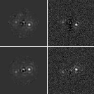
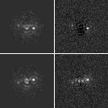
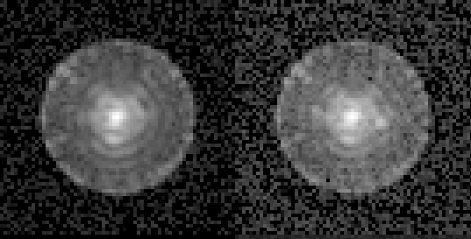
RDI With Detector Noise
Does not include rejection of high-jitter frames
Target - Reference
Target - Reference
No Sensitivity MUFs
Sensitivity MUFs
Noiseless
Noisy
Noiseless
Noisy
Summed Images
Reference
Target, Roll 1
Roll 1
Roll 1
1 x 10⁻⁸
3.5 λ/D
Roll 2
Roll 2
335 x 60s
gain = 100
(analog)
7080 x 5s
gain = 6000
(photon counting)
3 x 10⁻⁹
4.5 λ/D

Slide 21
Files in OS9 Distribution
(separate distributions are provided for with/without sensitivity MUFs)
os9_inputs.txt : Text table of the timestep (hours, beginning at 34) and the STOP-model-derived wavefront (Z4-Z45 in meters RMS, unobscured) and pupil shear (microns) changes relative to the 1st timestep (hour 34) in 5 min intervals (387 total). Timesteps during slews, rolls, or EFC wavefront maintenance are omitted. The Z4 value is the value after compensation by the focus correction mirror (including measurement error). The Z5-Z45 values are the raw, uncorrected Zernike aberrations.
os9_jitter.txt : Text table giving the post-FSM X and Y jitter (mas RMS per axis) versus time.
os9_images.fits : array [nx=200,ny=200,nlam=9,ntimes=387] of monochromatic speckle field images, each timestep corresponding to an entry in os9_inputs.txt. Each monochromatic image is the sum of the 4 polarization components and is primary-normalized flux. Sampling is 0.1 λ_{c}/D. Time-dependent jitter is included.
os9_psfs.fits : array [nx=200,ny=200,nr=19,nangle=10] of images at 0.1 λ_{c}/D sampling with the source offset by various amounts in radius (irregular offsets spanning the field) and angle (over one quadrant in 10 deg intervals). Broadband, primary-normalized flux with flat spectrum. Jitter not included. See “Offset Source Images” in a following slide for more info.
os9_psfs_r_offset.fits,
os9_psfs_angle_offset.fits : the corresponding offsets in radius (λ_{c}/D) from the center and angle (degrees) for os9_psfs.fits.
os9_planets_roll_-11deg.fits,
os9_planets_roll_11deg.fits : each is an array [nx=200,ny=200] containing a scene consisting of two planets of 10⁻⁸ contrast at 3.5 λ_{c}/D from the star and 3 x 10⁻⁹ contrast at 3.5 λ_{c}/D. The scenes are at orientations of -11° and +11°. Sampling is 0.1 λ_{c}/D. Broadband, primary-normalized flux with flat spectrum. Jitter not included.
os9_fluxes.txt : Table of wavelengths at which monochromatic images were generated, along with the corresponding fluxes (photons/sec) for each star.
os9_noiseless_ccd_images_no_planets.fits,
os9_noiseless_ccd_images_with_planets.fits: each is an array [nx=47,ny=47,ntimes=14735] of frames including speckles and with and without planets at CCD sampling (0.021”, 0.42 λ_{c}/D). Includes realistic fluxes appropriate for each spectral type & system transmissions, including QE. These are inputs to the EMCCD model, so they have no noise. They are in photons/sec/pix. The timesteps correspond to those in os9_frames_info.txt.
os9_ccd_images_no_planets.fits,
os9_ccd_images_with_planets.fits: each is an array [nx=67,ny=67,ntimes=14735] of frames including speckles and with and without planets at CCD sampling (0.021”, 0.42 λ_{c}/D). Includes realistic fluxes appropriate for each spectral type & system transmissions. Reference star (60 s frames @ gain=100) and target star (5 s frames @ gain=6000) images are all included. The timesteps correspond to those in os9_frames_info.txt. It is up to the user to extract the appropriate frames according to that file. The units are amplified electrons (ccd data numbers or ccd dn). The user must process reference star frames as analog mode (gain multiplied) images. The user must do photon-counting of the target star frames using the procedure described in an earlier slide.
os9_reference_processed_image.fits, os9_target_roll_-11deg_processed_image_with_planets.fits, os9_target_roll_11deg_processed_image_with_planets.fits: My processing of all of the CCD frames (analog for the reference, photon counting with correction for the target) with conversion to photons/sec (mean of region outside of dark hole subtracted). Divide by stellar flux given in header to normalize.
os9_frames_info.txt: Text table that provides, for each corresponding timestep in os9_ccd_images*.fits, the following: timestep of frame start in hours, star ID (0=reference, 1=target), observation cycle ID (starting with 1), roll angle in degrees, image ID (starts at 1, each set of star frames coadd into a single image), then the exposure time of the frame.

Slide 22
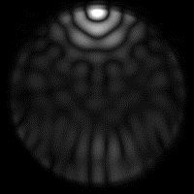
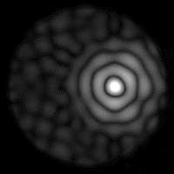
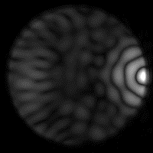
Offset Source Images
os9_psfs.fits contains images of a flat-spectrum source
offset by various amounts in radius and angle from the
center of the FPM over one quadrant of the dark hole.
It is a [nx,ny,r,θ ] = [200,200,19,10] array. The images
are primary-flux-normalized.
These 200 x 200 pixel images are sampled by 0.1 λ_{c}/D.
It is up to the user to resample these to the detector
pixel size (0.42 λ_{c}/D). I do this by upsampling via
interpolation from 0.1 λ_{c}/D to 1/9 the detector pixel size,
and then bin down to detector pixels. Be sure to conserve
flux at each step.
The corresponding offsets in radius (λ_{c}/D) and angle
(degrees) are provided in the files os9_psfs_r_offset.fits
and os9_psfs_angle_offset.fits. Each is a [19,10] array.
The offsets are:
r = 1.0, 2.0, 2.2, 2.4, 2.6, 2.8, 3.0, 3.2, 3.4, 3.6, 3.8, 4.0, 5.0, 6.0, 7.0, 8.0, 8.3, 8.6, 8.9 λ_{c}/D
θ = 0, 10, 20, 30, 40, 50, 60, 70, 80, 90 degrees
r = 8.9 λ/D,
θ = 90°
r = 3 λ/D,
θ = 0°
r = 8.9 λ/D,
θ = 0°

Slide 23
OS9 Electric Field Distribution
The complex-valued OS9 electric fields were requested
They are provided in a separate file archive and contain the real & imaginary parts
  os9_efields_real.fits, os9_efields_imaginary.fits
Each array is [nx=200,ny=200,nlam=9,npol=4,ntimes=387]
  sampling is 0.1 λ_{c}/D
  there are 4 polarization states, respectively: -45°_{in}/+90°_{out}, -45°_{in}/0°_{out}, +45°_{in}/0°_{out}, +45°_{in}/+90°_{out}
  the timesteps correspond to those listed in os9_inputs.txt, which can be cross-referenced in time to star ID and roll in os9_frames_inputs.txt
  each monochromatic, single-polarization-component field is normalized such that the fluxes are primary-normalized when converted to intensity
Jitter is not included
Includes LOWFS/C corrections to Z4-Z11

Slide 24
Common File Header Keywords
MINLAM, MAXLAM = min, max bandpass wavelength in microns
LAMBDA = bandpass central wavelength in microns
PIXSCALE = Spatial sampling in LAMBDA/D
PIX_AS = Spatial sampling in arcseconds
XCENTER, YCENTER = image coordinate of FPM center (0.0,0.0 is lower left edge of 1st pixel; center of any pixel is (*.5,*.5)
UNITS = data value units; for images, flux units
CCD images include keywords specifying noises

Slide 25
Wavelengths, Spectral Weights
9 monochromatic images are generated over evenly-spaced wavelengths to create an HLC Band 1 broadband image
Bandpass min, max, and center wavelengths given in file headers
Wavelengths and corresponding flux rates for each star are given in os9_fluxes.txt
  The fluxes include losses from reflections, filters, CCD QE, but not masks (the output of the diffraction model has mask losses)

