Slide 1
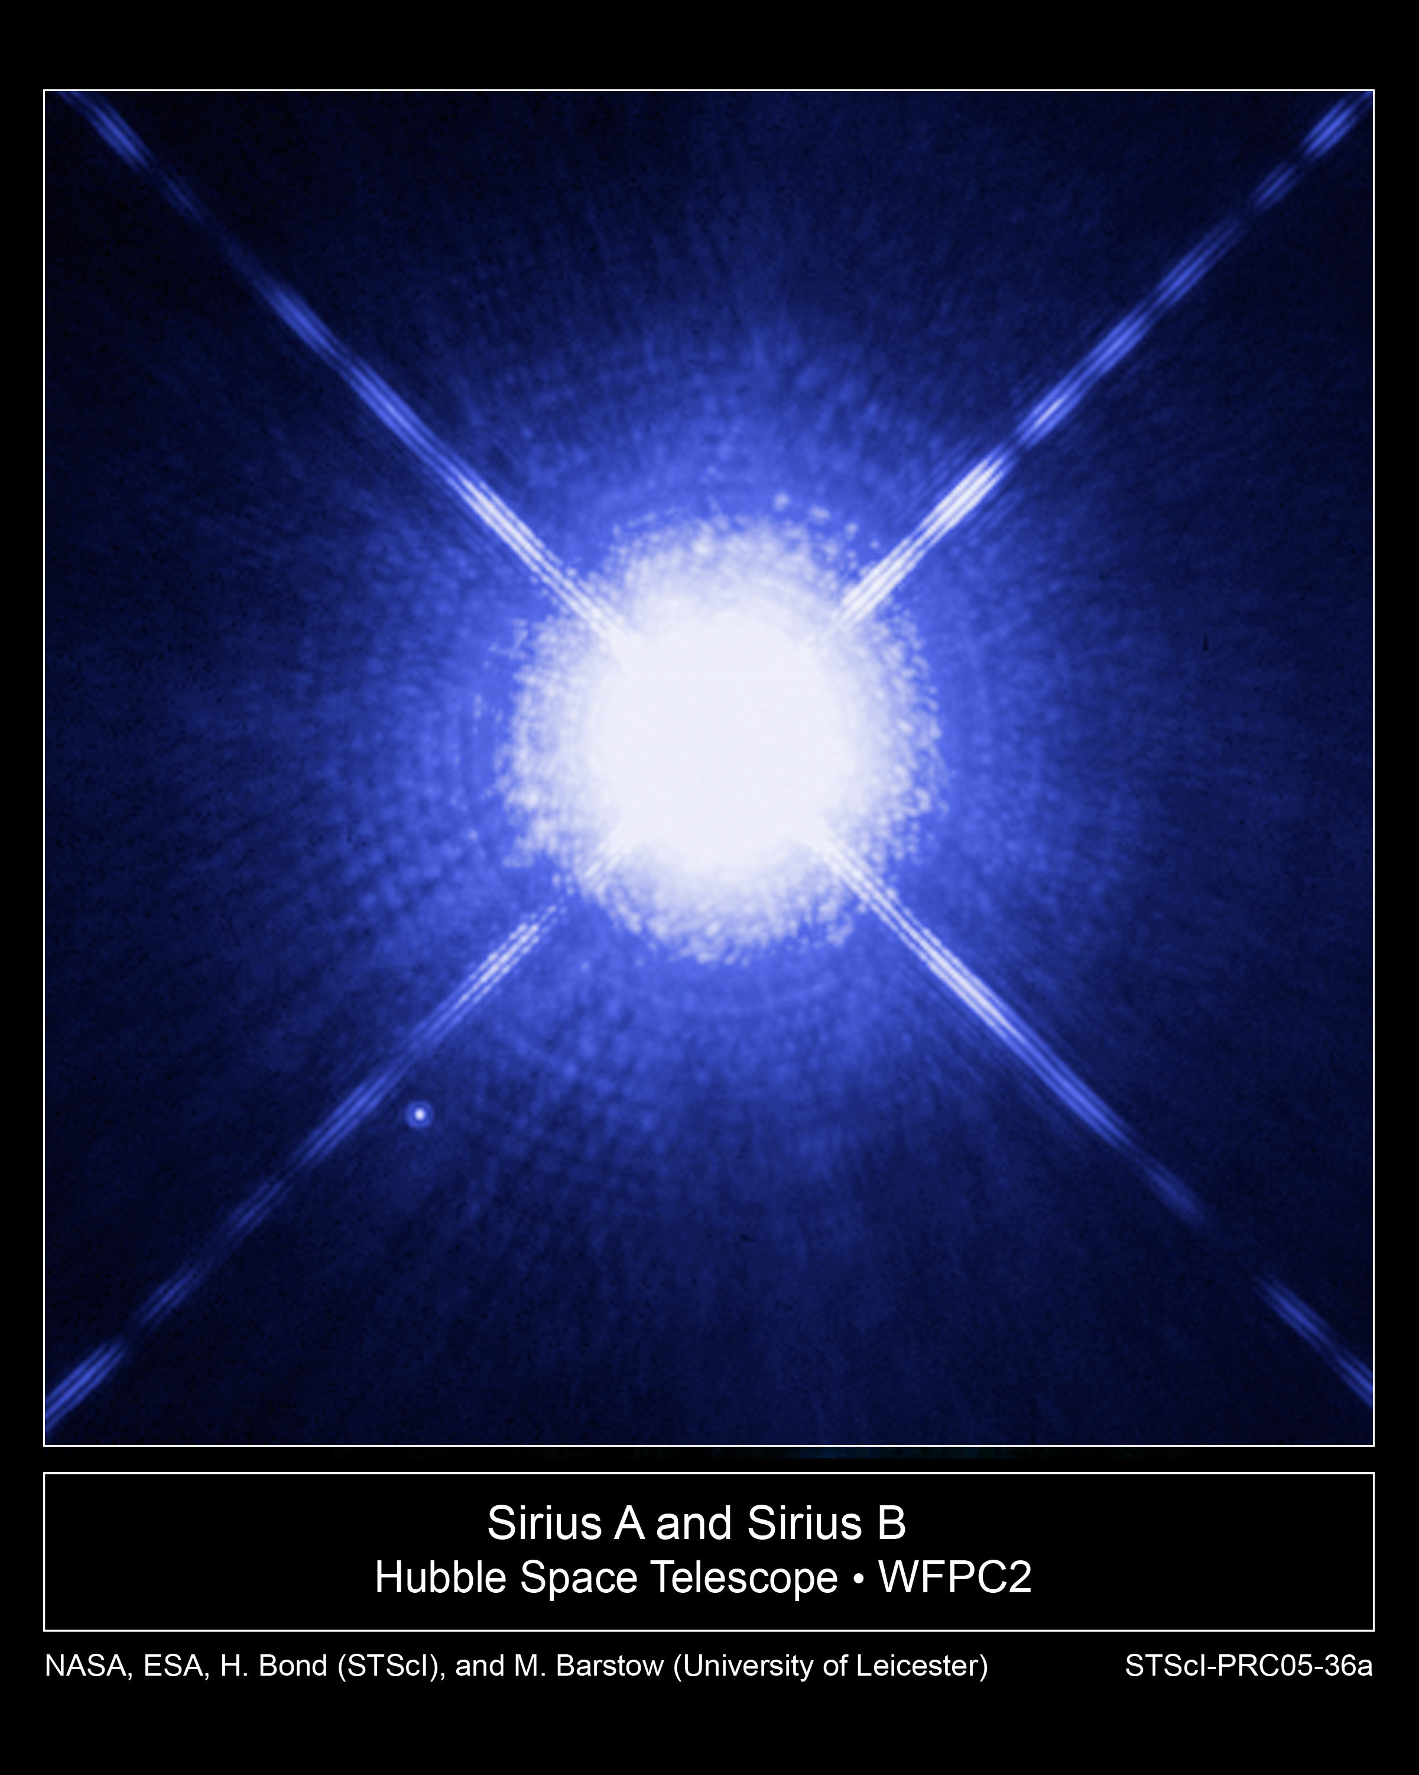
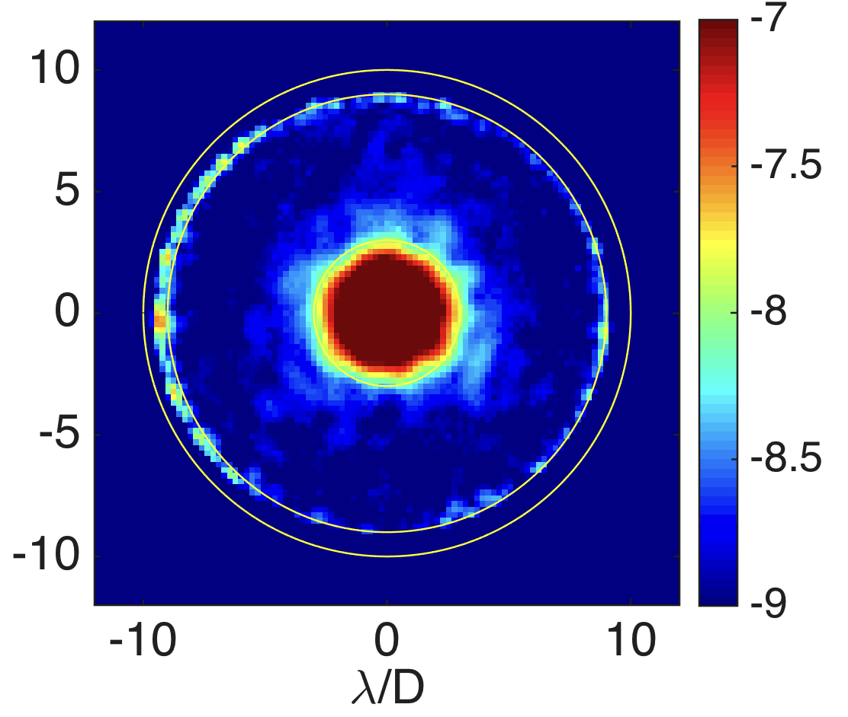
The WFIRST Coronagraph Instrument (CGI)
  CGI is one of two instruments on WFIRST
    launch 2025
  Exoplanets are challenging to directly image
    The planet is lost in the glare of the star
  The best star to planet light flux ratio we can detect today is 10⁶
    10,000 times less than needed to image an Earth analog
  WFIRST CGI, a technology demonstration of space-based direct imaging, will be ~100-1,000 times better than any current telescope
    CGI will pave the way for future missions capable of taking spectra of Earth analogs
  CGI will achieve pioneering science in direct imaging and spectroscopy of mature Jupiter analog exoplanets and circumstellar disks seen in visible reflected starlight
Notes:
Top Image: Image of a bright star (Sirius) with HST. A faint planet orbiting close to the star would be lost in the glare. The orange circle is the field of view of CGI.
Bottom Image: CGI lab demonstration of 1 billion to one contrast
Imaging a planet around a nearby star is really challenging. Imagine trying to see a firefly buzzing near a lighthouse. Now imagine that firefly is buzzing 20ft away from that lighthouse and you’re trying to see it from 1500 miles away (CA to MN). That’s what we can do today. To see an Earth-like planet around a Sun-like star, we need to do 10,000 times better than that. Replace that firefly with a single cell of bioluminescent algae.
The problem, of course, is that alga is lost under the glare of the lighthouse. The planet is lost in the glare of the star. (top image) We will have to specially design a telescope and instrument that block the starlight to see the extraordinarily faint planet. (bottom image)
A factor of 10,000x improvement is too much to do in one giant leap. CGI is a direct predecessor to these missions, and is a crucial step in the exploration of Sun-like planetary systems
CGI will be 1,000x better that any current telescope, and will be capable of seeing Jupiter-like planets around nearby stars. It will also be able to see
‘protoplanetary disks’ – the disk of dust and gas around a very young star out of which planets form
‘debris disks’ - the remnant material from planet formation, akin to massive versions of our asteroid or Kuiper belts
‘exozodiacal disks’ – the remnant material from planet formation and evaporating comets, akin to the dust that causes zodiacal light in our solar system
Details about top image: This Hubble Space Telescope image shows Sirius A, the brightest star in our nighttime sky, along with its faint, tiny stellar companion, Sirius B. Astronomers overexposed the image of Sirius A [at center] so that the dim Sirius B [tiny dot at lower left] could be seen. Sirius B is about 10,000 times fainter than Sirius A.
The cross-shaped diffraction spikes and concentric rings around Sirius A, and the small ring around Sirius B, are artifacts produced within the telescope's imaging system. Sirius B is about 10,000 times fainter than Sirius A, but it can be seen in this image because it is orbiting far away from Sirius A. (about 6 arcseconds) If we wanted to image planets orbiting close to Sirius A, or any other star, they would be much more difficult to detect, because of the glare of the star.
Details about bottom image:
This is a lab image taken with a WFIRST CGI prototype at JPL. The color scale is tells you how faint a planet you could detect at each position. In the darkest blue regions, you could see a planet that’s 1 billion times fainter than its star. [The point source is just powerpoint art, not a real source!]
Technical details: 360 deg dark hole, with a contrast ratio of 10-9 from 3 λ/D to 8 λ/D at wavelength λ, where D is the telescope diameter. Results shown are unpolarized light with a 10% bandwidth centered at 0.55 µm. (Jun-Byoung Seo et al., private communication, Dec. 2016).
Side note: what astrophysical measurements have been done on Sirius and why do we care? The two stars revolve around each other every 50 years. Sirius A, only 8.6 light-years from Earth, is the fifth closest star system known. Sirius B, a white dwarf, is very faint because of its tiny size, only 7,500 miles in diameter. White dwarfs are the leftover remnants of stars similar to the sun. They have exhausted their nuclear fuel sources and have collapsed down to a very small size.Using the keen eye of Hubble's Space Telescope Imaging Spectrograph (STIS), astronomers have now been able to isolate the light from Sirius B and disperse it into a spectrum. STIS measured light from Sirius B being stretched to longer, redder wavelengths due to the white dwarf's powerful gravitational pull. Based on those measurements, astronomers have calculated Sirius B's mass at 98 percent that of the sun. Analysis of the white dwarf's spectrum also has allowed astronomers to refine the estimate for its surface temperature to about 44,900 degrees Fahrenheit (25,200 degrees Kelvin).
Accurately determining the masses of white dwarfs is fundamentally important to understanding stellar evolution. The sun will eventually become a white dwarf. White dwarfs are also the source of Type Ia supernova explosions, which are used because of their brightness to measure the distance to distant galaxies and the expansion rate of the universe. Measurements based on Type Ia supernovae are fundamental to understanding "dark energy," a dominant repulsive force stretching the universe apart. Also, the method used to determine the white dwarf's mass relies on one of the key predictions of Einstein's theory of General Relativity: that light loses energy when it attempts to escape the gravity of a compact star. This effect is known as the gravitational redshift of the light.
This image was taken Oct. 15, 2003, with Hubble's Wide Field Planetary Camera 2. Based on detailed measurements of the position of Sirius B in this image, astronomers were then able to point the STIS instrument exactly on the white dwarf and make the measurements to determine its gravitational redshift and mass.
Tags
Hubble Telescope, Multiple Star Systems, Observations, Stars, White Dwarfs
Credits
NASA, H.E. Bond and E. Nelan (Space Telescope Science Institute, Baltimore, Md.); M. Barstow and M. Burleigh (University of Leicester, U.K.); and J.B. Holberg (University of Arizona)

Slide 2
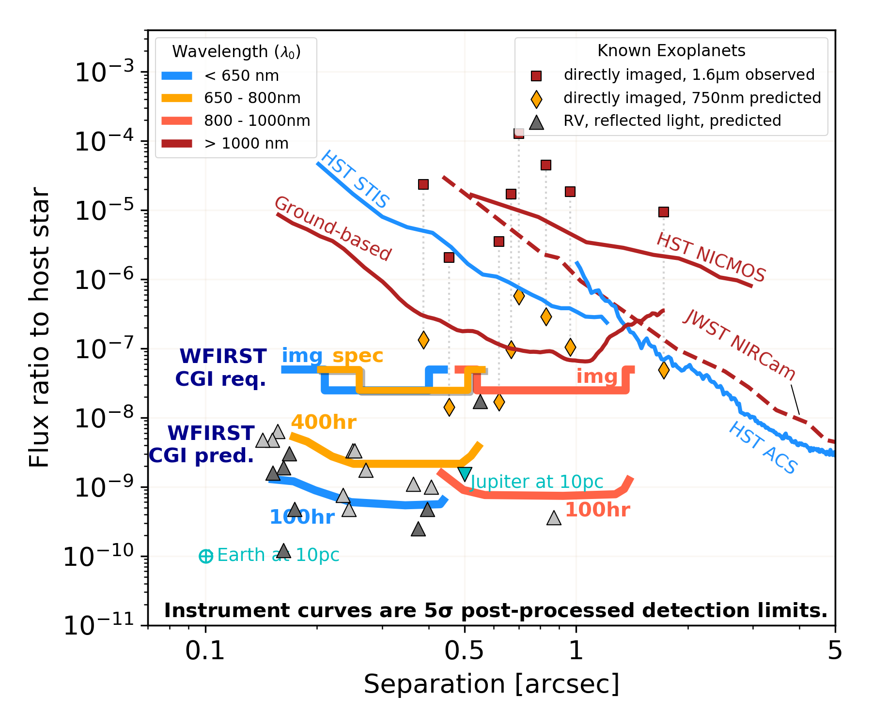
CGI in Context
WFIRST CGI is a technology demonstration of space-based direct imaging and spectroscopy
  will be ~100-1,000 times better than any current facility
  a critical stepping stone in preparation for future exo-Earth missions
A Participating Scientist Program will enable members of the community to engage in the technology demonstration phase.
  If warranted by instrument performance, the PSP may perform science operations beyond the 18 month technology demonstration period.
https://github.com/nasavbailey/DI-flux-ratio-plot
“RV” planets: planets already detected using the Radial Velocity technique and with minimum masses > 0.25 Jupiter mass
Notes:
Current coronagraphs are limited to the detection of bright, young exoplanets far from their stars
CGI’s predicted performance allows the study of planets a billion times fainter than their host star and located > 0.15” away
The Figure shows WFIRST/CGI’s predicted measurement precision in terms of measured flux ratio and planet-star separation -> CGI provides improved precision and access to small working angles
Current coronagraphs are limited to the detection of bright (self-luminous) young exoplanets, a million times fainter than their host star and located > 0.3” away
Even minimal success with CGI, i.e. just meeting its technology demonstration requirements, will enable detecting planetary companions 20 million times fainter than their host star and located > 0.15” away
Performance predictions based on lab results imply the detection of planetary companions a billion times fainter than their host star and located > 0.15” away
CGI provides a crucial stepping stone in the preparation of future missions aiming to image Earth-like planets 10 billion times fainter than their host star and located 0.1” away by demonstrating multiple coordinated technologies in space for the first time

Slide 3
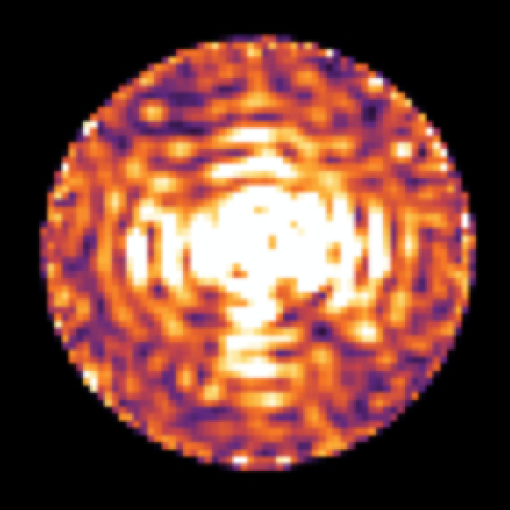
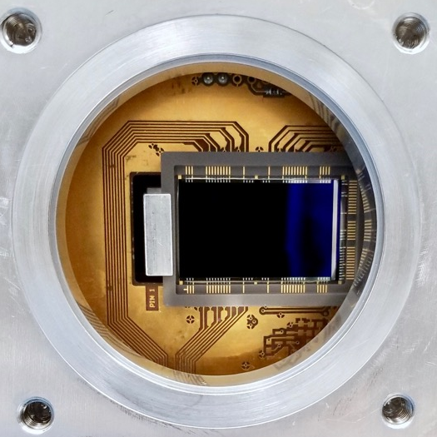
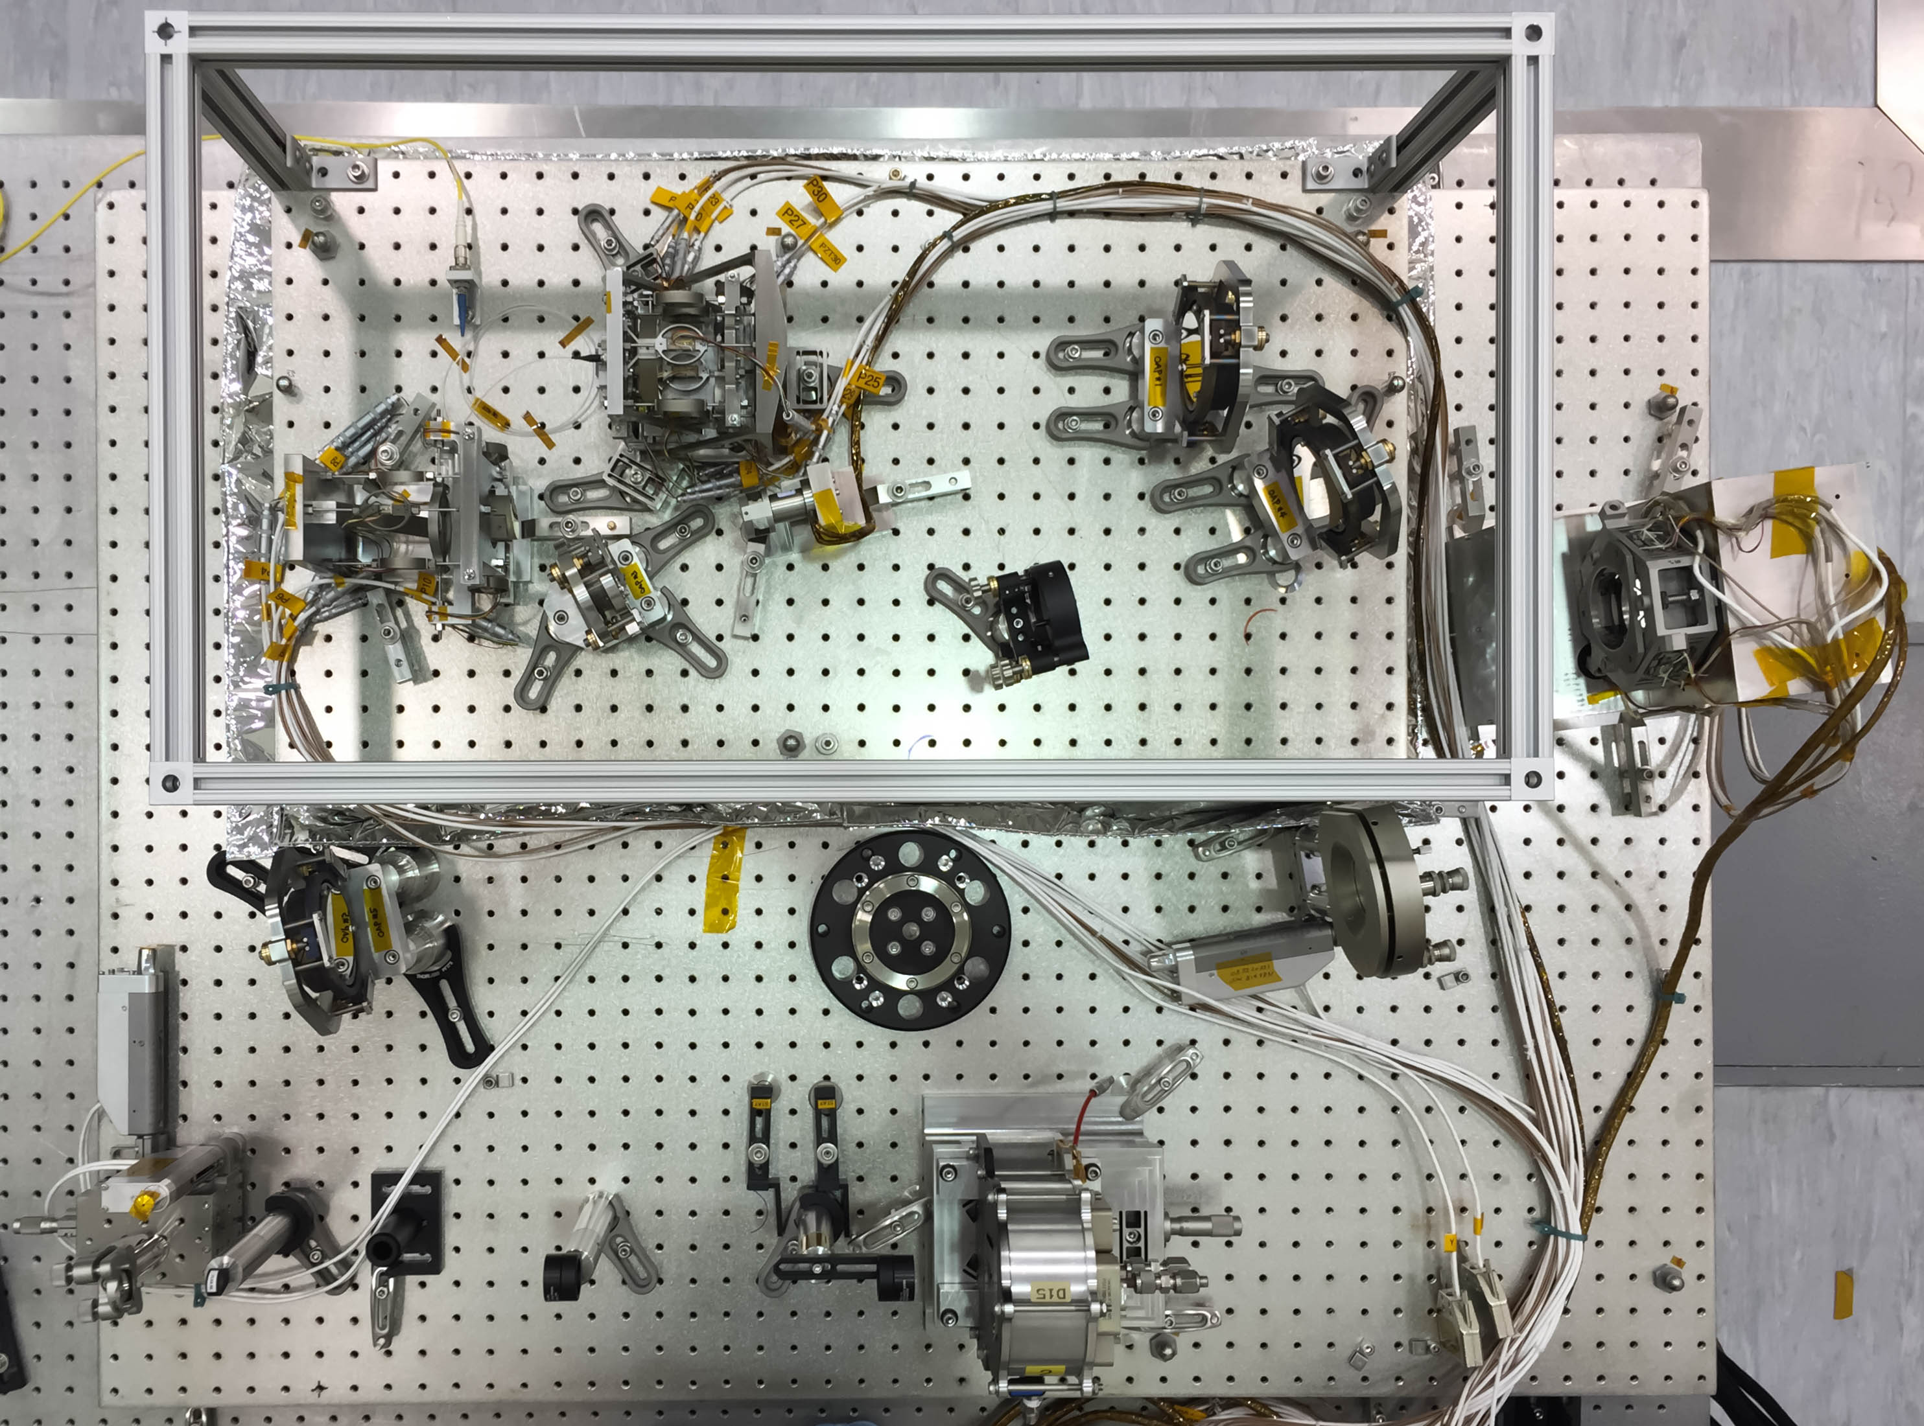
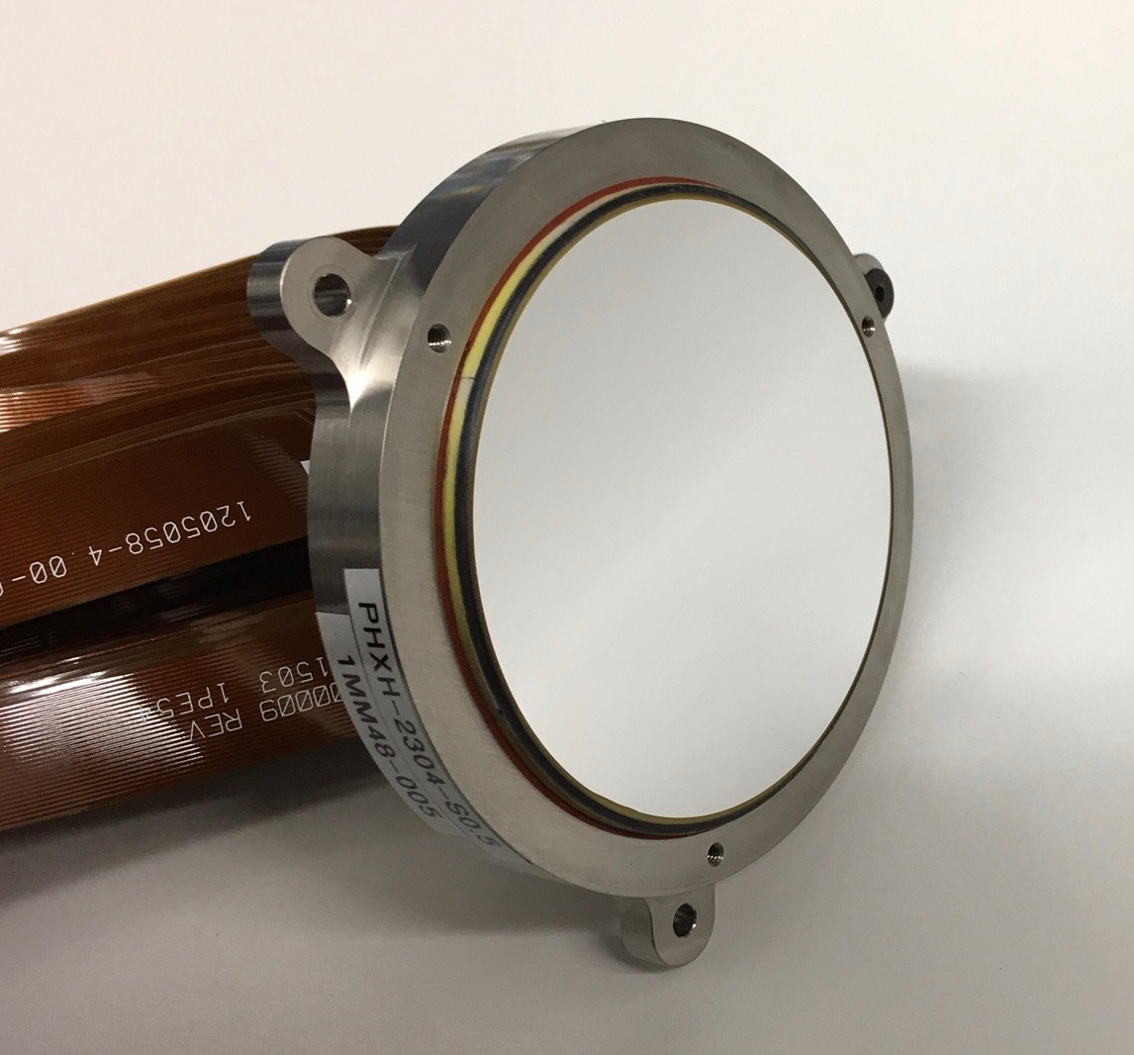
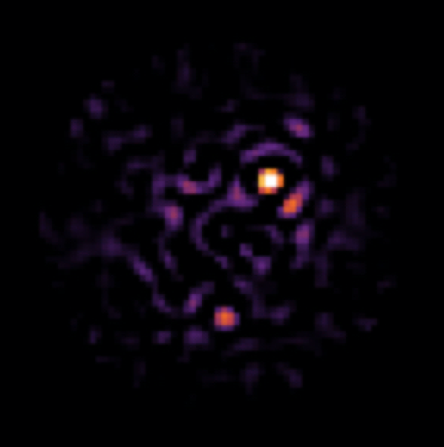
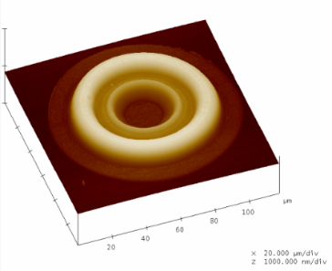
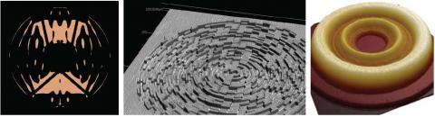
Critical Technology Demonstrations
CGI is an advanced technology demonstrator for future missions that will directly image Earth-like exoplanets.
High-contrast Coronagraph Masks
Ultra-low noise photon counting EMCCD Detectors
Data Post-
Processing
Autonomous
Ultra-Precise Wavefront Sensing & Control
Large-format Deformable Mirrors
Bertrand Mennesson (JPL)
  CGI will be the first space-based demonstration of technologies that will be needed to image and characterize rocky planets in the habitable zones of nearby stars.
  CGI is a direct predecessor to future missions such as HabEx and LUVOIR missions, and is a crucial step in the exploration of Sun-like planetary systems
Notes:
CGI is an advanced technology demonstrator for future missions that will directly image Earth-like exoplanets. (e.g. HabEx and LUVOIR)
As discussed before, these future missions to image earth-like planets will have to perform 10,000x better than today’s facilities. By demonstrating these tools in an integrated end-to-end system and enabling scientific observing operations, NASA will validate performance models and provide the pathway for potential future flagship missions.
In short, CGI achieves that capability through improvements in several areas:
Hardware: space-qualified (TRL9) deformable mirrors, detectors, and coronagraphs
Algorithms: wavefront sensing and control; post-processing of integral field spectrograph, polarimetric, and extended object data
Validation of telescope and instrument models at high accuracy and precision
Suppressing the starlight requires a combination of two things:
blocking as much starlight as possible with “coronagraph masks,” (think of how you use your hand to block the sun if you want to see a plane flying by)
Automatically measuring the remaining glare and correcting for it with a “deformable mirror.” Since light is a wave, astronomers call this process “wavefront sensing and control.” Deformable mirrors must be shaped very precisely in real time.
CGI will be the first space telescope with high-performance wavefront sensing and control. One of CGI’s primary goals is to figure out how to translate this ground-based technology into a hardy, space-qualified system, while simultaneously improving its performance by orders of magnitude. State of the art ground-based systems today can sense and correct wavefront errors to <100 nanometers (RMS). CGI must stabilize the wavefront to <100 picometers (RMS), and future exo-Earth imaging missions aim for <10 pm RMS.
CGI’s specially-designed coronagraph masks block starlight much better than those on current telescopes. These designs also have to be robust to effects that aren’t important at today’s poorer level of performance (such as accounting for the differences between the image quality in each polarization of light).
CGI will have advanced scientific cameras. It will include an ‘integral field spectrograph’ – a type of camera that takes a low resolution spectrum at every point in the image simultaneously. The most novel technology, though, is the electron-multiplying CCD (EMCCD) detector. This detector has exceptionally good sensitivity at very low light levels, and CGI will use it in uncharted territory – photon counting mode. A Jupiter-like planet around a nearby star is so faint that CGI will only receive photons from it once every couple minutes. CGI will literally count the photons as they arrive. JPL is working to space qualify these EMCCDs and characterize their performance at an unprecedented level of precision.
CGI must also build sophisticated data processing software, because even the precision coronagraphs + wavefront sensing and control can’t remove all the starlight. Data processing software must be able to remove the last of the remaining starlight to uncover the faint planets beneath.

Slide 4
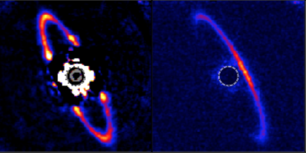
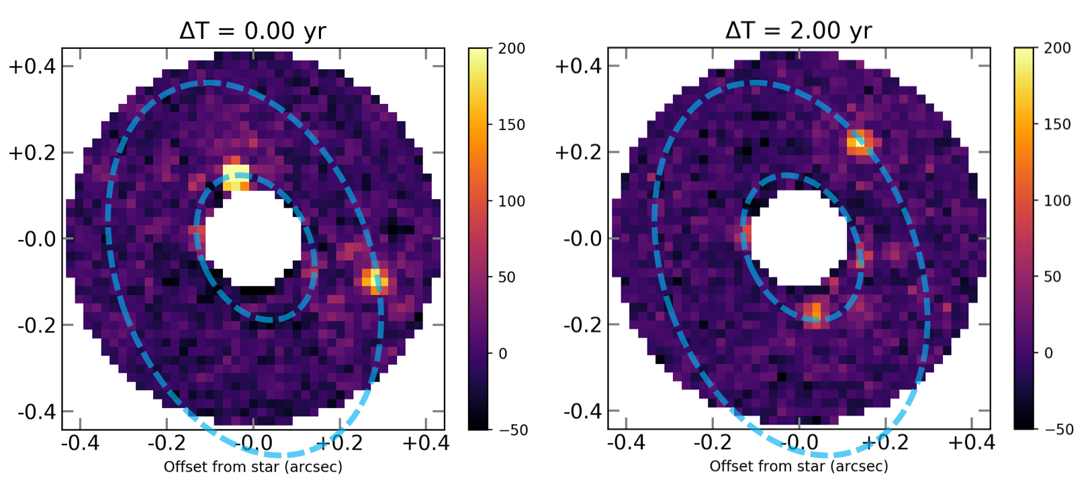
CGI Science Themes
Self-luminous,
Young Super Jupiters:
Atmospheric Properties
Circumstellar disks:
Protoplanetary (young)
Debris (mature)
Exozodi (mature, HZ)
Blind Searches for Exoplanets
WFIRST CGI
Passbands
Imaging
Spectroscopy
Spectroscopy
Imaging
Mark Marley (Ames)
Garret, Savransky & Macintosh (2017 )
Mature Jupiter Analogues in Reflected Light:
Atmospheric Properties
John Debes (STScI)
Orbital Solution and
Mass Measurement
Marshall Perrin et al. (2015)
Natasha Batahla & Mark Marley (Ames)
Neil Zimmermann (GSFC)
Notes:
Self-luminous, young super Jupiters:
CGI will be able to distinguish between clear and cloudy atmopsheres
Planet to star contrast as a function of wavelength for young, self-luminous giant planets with and without clouds. The effective temperatures of the star and planet are 6000K and 1100K.
Mature Jupiter analogues in reflected light:
CGI will probe the metallicity and cloud composition of Jupiter analogues
Circumstellar disks:
Top: CGI will enable the study of lower density circumstellar disks and regions closer to the star, including exozodiacal dust in the habitable zone. Plot shows predicted CGI disk imaging performance in the context of HST detection limits and surface brightness profiles of previously-resolved disks and exozodi predictions. Surface brightness units are flux ratio per resolution element.
Bottom: Left panel: Gemini/GPI total intensity on the left and linear polarized fraction on the right; the addition of polarimetry allows CGI to study the scattering properties of the circumstellar material, allowing insights into the geometry of the disk as well as new insights into grain properties: size and composition
Possible blind searches for giant planets:
What fraction of planets you could detect in different regions of parameter space during a blind search with CGI (the average for the 10 best stars). Plot is generated using the methodology in the cited paper, but has been updated with the latest CGI performance predictions.
"If we look at these ten stars, we have an expectation (with a fairly large standard deviation, not captured in this plot, plus other moments as the distribution is not strictly Gaussian) of detecting 50% of all planets in the relevant contour, given that we can achieve the assumed WFIRST post-processed contrast on each star."
This plot gives the mean probability for the 10 best stars that we’d see a planet at a given separation and mass, assuming that planet is there at all. In other words, this is a capability plot NOT a yield plot! The 50% contour does NOT mean that we have a 50% chance of discovering a planet in that region of parameter space if we search those 10 stars.
So, if we were to look at any 1 star, it would have a 50% chance of finding a planet in that region of parameter space if it is there
Giant planets (>5 Earth radii) are found most frequently (>50%) while the CGI is barely sensitive to 2 Earth-radii planets (0.5%). Albedos were assumed to be uniformly 0.2 for planets below 1.4 Earth radii and 0.5 for larger planets.
Orbital Solution Measurement:
CGI will measure the orbital solution of planets that have been previously detected via the radial velocity method, allowing the direct measurement of a planet’s orbital inclination, providing a crucial constraint on m*sin(i), and allowing us to directly measure the planet’s mass

Slide 5
Potential for science observations with CGI
CGI science capability will depend on:
  CGI Performance
  Time devoted to CGI observations
A Participating Scientist Program will enable members of the community to engage in the technology demonstration phase.
  If warranted by instrument performance, the PSP may perform science operations beyond the 18 month technology demonstration period.
Raw Contrast Science | 10⁻⁹ | 3×10⁻⁹ | 10⁻⁸ | 10⁻⁷
Cool EGPs optical spectra | Yes (10+) | A few | No | No
Cool EGPs optical Images | Yes | Yes | Possibly | No
Young EGPs optical spectra | Yes | Yes | Yes | Some
Young EGPs optical images | Yes | Yes | Yes | Some
Exo-Zodi Disks optical images | ~1 zodi | ~3 zodis | ~10 zodis | ~100 zodis
EGP: Extrasolar Giant Planet
Bertrand Mennesson (JPL)
Notes:
Shown in the table are our “unofficial” scientific goals that will potentially be achieved after the Technology Demonstration
The first 3 columns are better than our requirements (10^-9, 3x10^-9, and 10^-8)
The quality and quantity of possible scientific observations with CGI will really depend on demonstrated performance and total observing time
Vanessa Edit: Took out the mention of a full GO program, because I’m didn’t think that’s officially on the table at this point

